Slide 1
EENG 385 555 Timer
Notes:
Usually the <title of the lab> is what will be called the “System” through the rest of this document

Slide 2
Lab Objectives
Analyze how the 555 timer in the BJT curve tracer operates using theory, simulation and experimentation. You will compare these three methods and develop your intuition about how well theory and simulation should be trusted.

Slide 3
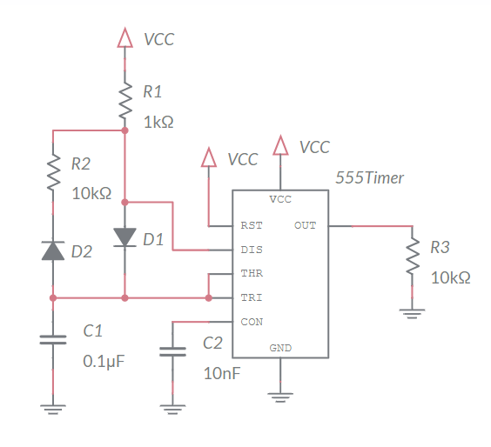
Analyze
Produces oscillating waveform
Low duty cycle
Will be used later in curve tracer
Notes:
Replace <System> with the name of the

Slide 4
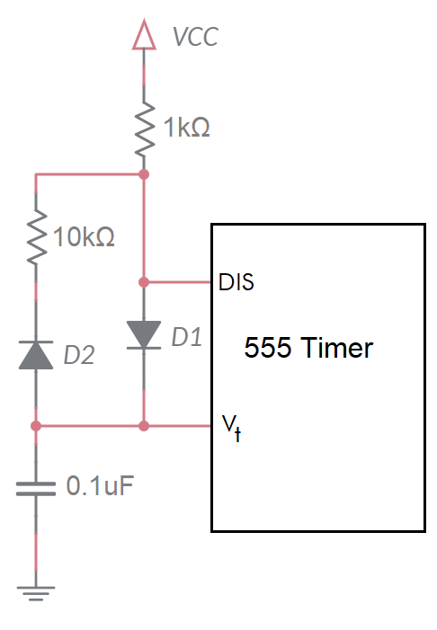
Analyze
DIS pin is either open circuit or GND
Open circuit = charging 100nF capacitor
GND = discharge 100nF capacitor
Charging Mode
1k and 100nF in series
Determine time to charge cap from 3V to 6V
Discharging Mode
10k and 100nF in series
Determine time to discharge cap from 6V to 3V
Notes:
Replace <System> with the name of the

Slide 5
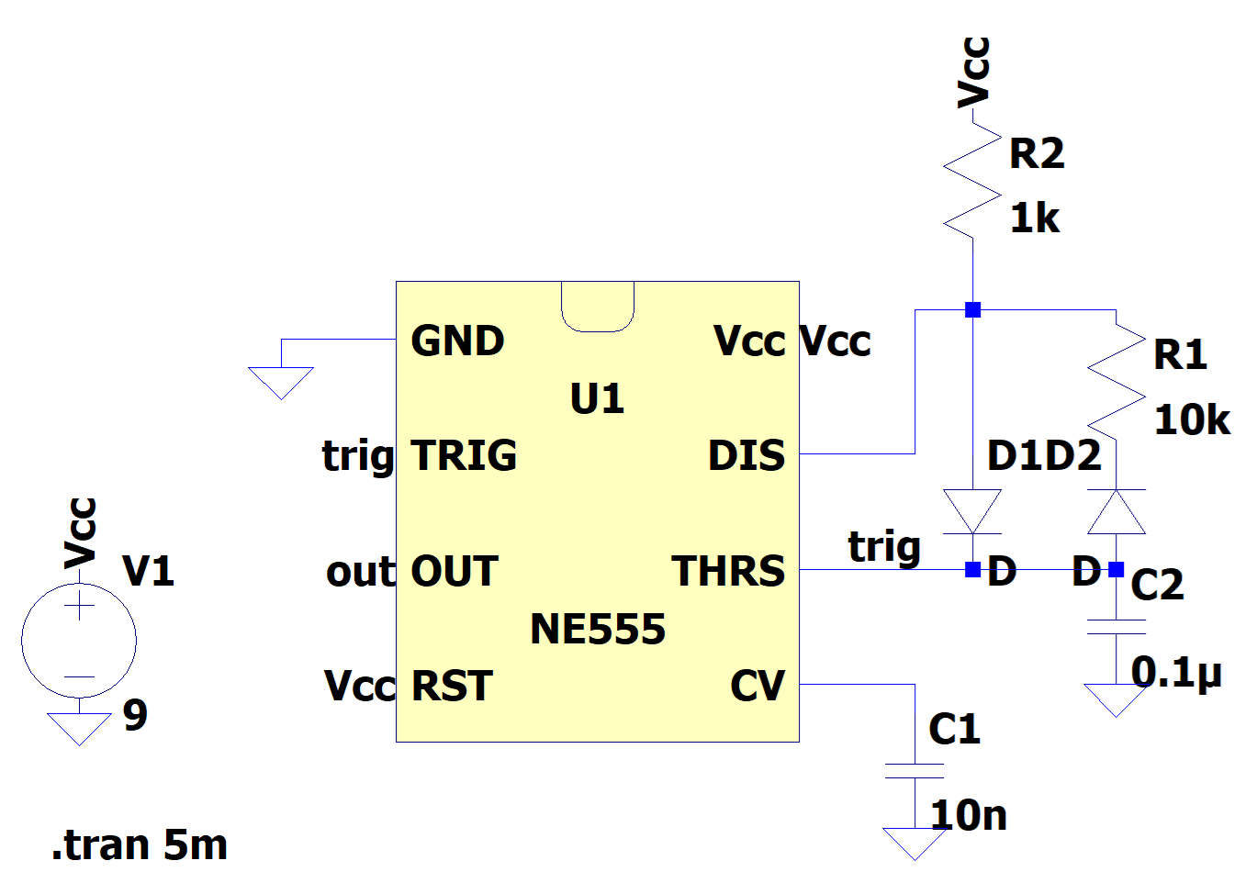
Simulate
Net Names | trig, out, Vcc
Component | NE555
Waveform Nets | trig, out
Configure Analysis | Transient, Stop Time 5ms

Slide 6
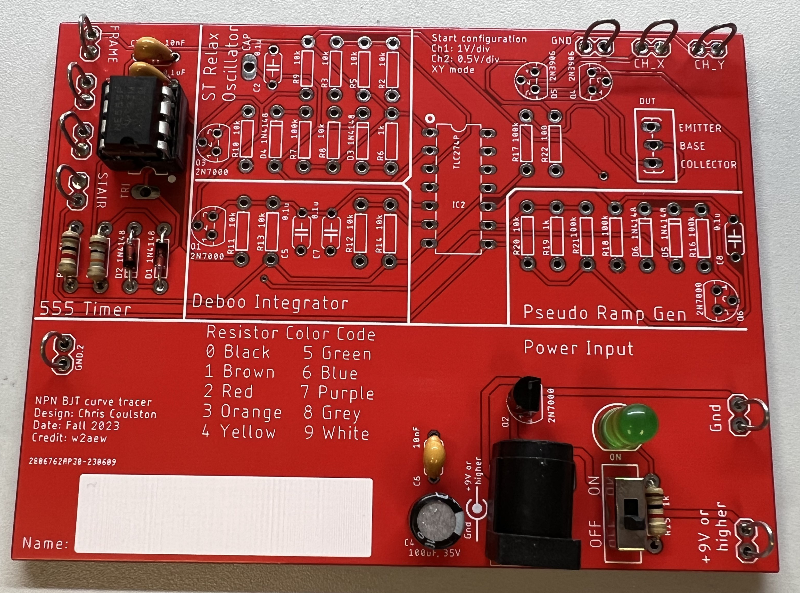
Assemble
Assemble 555 and PWR
Nothing else!
Use eye protection
Solder in Brown 303
Apply power using Vcc Gnd
Reverse voltage protection

Slide 7
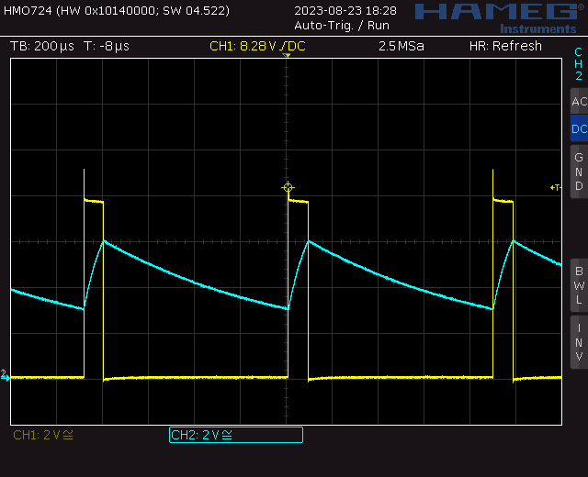
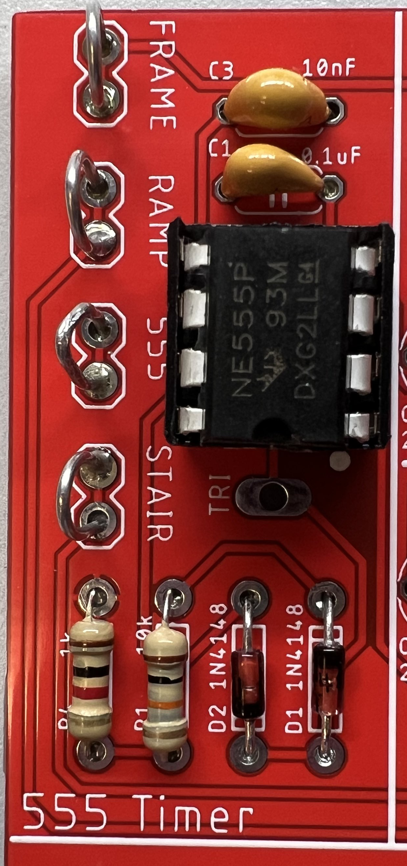
Test your circuit
Probe output 555 loop yellow trace
Probe TRI TRI pad blue trace

Slide 8
Turn In
Answer listed questions
Save solutions as PDF
Due before start of lab next week
Every student builds their own board
Everyone brings their board to class
Sign your board with your name!

